Slide 1
Chapter 7: Cloud Computing Security
Dr. E.B.Fernandez

Slide 2
What is Cloud Computing?
Wikipedia: Cloud computing is the delivery of computing as a service rather than a product, whereby shared resources, software, and information are provided to computers and other devices as a metered service over a network (typically the Internet).
NIST (National Institute of Standards and Technology): Cloud computing is a model for enabling convenient, on-demand network access to a shared pool of configurable computing resources (e.g., networks, servers, storage, applications, and services) that can be rapidly provisioned and released with minimal management effort or service provider interaction

Slide 3
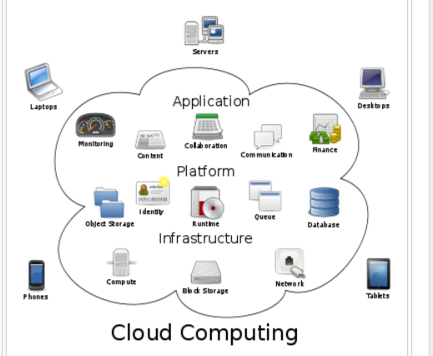

Slide 4
Service-Oriented Architecture (SOA)
A service is a logical representation of a business activity that has a specified outcome
SOA is an architectural style in which a system is composed from a set of loosely coupled services that interact with each other by sending messages
In order to interoperate, each service publishes its description, which defines its interface and expresses constraints and policies that must be respected in order to interact with it.
Applications are built by coordinating and assembling services (workflow style)
A key principle about services is that they should be easily reusable and discoverable, even in an inter-organizational context

Slide 5
Cloud services
A cloud service has three distinct characteristics that differentiate it from traditional hosting. It is sold on demand, typically by the minute or the hour; it is elastic -- a user can have as much or as little of a service as they want at any given time; and the service is fully managed by the provider (the consumer needs nothing but a personal computer and Internet access)
Significant innovations in virtualization and distributed computing, as well as improved access to high-speed Internet, have accelerated interest in cloud computing.
Almost all kinds of institutions use clouds now

Slide 6
User view
The illusion of infinite computing resources available on demand. Cloud providers allow users to increase/decrease resources depending on their needs.
Accessibility to resources from anywhere (Internet)
The reduction of an up-front commitment by users. Minimize up-front costs associated with on-premise hardware and software license.
The ability to pay only for use of computing resources as needed. Clouds offer pay-as-you-go services to the public where users only pay for the services consumed.

Slide 7
Core services
Software as a Service (SaaS), An infrastructure that runs customer services and provides those services for the customer itself or for its own customers
Platform as a Service (PaaS), A platform where a customer can run his applications in a configured execution infrastructure.
Infrastructure as a Service (IaaS). A hardware service where customer applications can be executed.

Slide 8
Cloud services

Slide 9
Architectural layers
User interfaces
User Applications:
SaaS
financial manufacturing
student registration
DBMS
SQL
..
NoSQL
..
OS utilities Media Player Browser
PaaS
OS kernel
processes memory
device control file system
distribution middleware services
Networking
IaaS
Hardware: Processors Storage I/O devices

Slide 10
Other types of services
Security as a Service—authentication, authorization,…
Identity as a Service—standardization of identities
Database as a Service (DaaS)—modeling, transactions,…
Big Data as a Service (BDaaS)
Cells as a Service—cells contain VMs, storage, and subnets, described in an XML document and are units of isolation
Application as a Service—access to user-specified applications across clouds
Business Processes aaS
Crime aaS—use the cloud to hack systems
Networks aaS—Network function virtualization
Anything aaS

Slide 11
Cloud Deployment
Public – public clouds are run by third party providers. They provide services to any client who pays for their services. Public clouds are preferable for non-critical applications that are related to few core processes of the organization.
Private – private clouds are built for the exclusive use of an institution, providing strong control over data, security, and quality of service. Private clouds can be built and managed by the organization or by a cloud provider.
Hybrid – combines the two previous approaches. Hybrid clouds are environments in which an organization manages some resources in-house and uses external clouds for other services.
Community – community clouds might be established where different organizations that share similar requirements want to share the infrastructure. Community clouds can be deployed using any of the three models mentioned before.

Slide 12
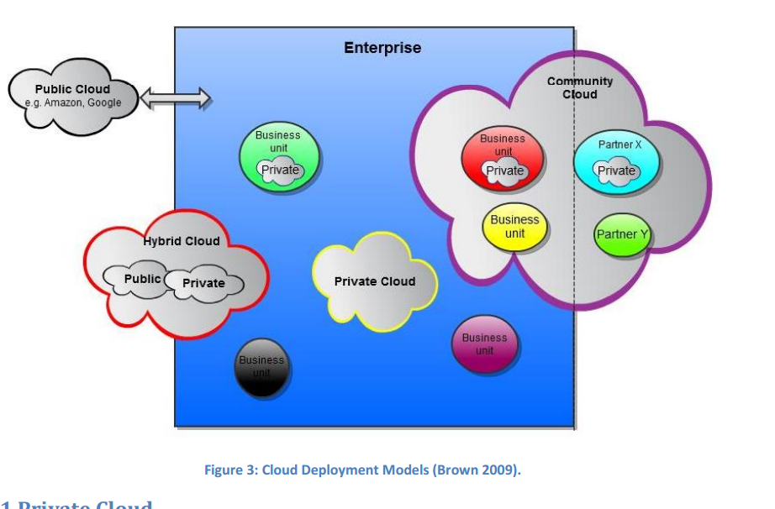

Slide 13
Service Model Architectures

Slide 14
Software as a Service (SaaS)
The user rents software from the cloud provider instead of buying it. The software is hosted in the data center managed by the provider, and it is available over the network, typically the Internet. Examples of SaaS: CRM, ERP, Word Processor, Spreadsheet, database applications, etc.
SaaS has the following characteristics:
Access via the web: end users access the application via the Internet using a web browser instead of the traditional PC-based client.
Vendor support: the application is hosted and operated by the cloud provider.
Subscription Pricing: users only pay only for what they use. They do not invest on upfront fees such as licensing fees.
Low Customization: the applications are highly standardized across customers, often hosted in a “multi-tenant” architecture model.
Managed Upgrades: functionality enhancements such as upgrades and installations are completely controlled by the vendor.

Slide 15
Platform as a Service (PaaS)
It offers an environment for developers where they can develop, test, and run their applications
A programming platform is offered to the user (developer), which provides a complete software lifecycle management, from planning to design to building applications to testing to maintenance
Two examples are Google’s App Engine and Force.com. Google’s App Engine offers APIs for storage, platform, and database. It supports applications written in different programming languages such as Java and Python. The Force.com platform is similar, but it uses a custom programming language called Apex.

Slide 16
Infrastructure as a Service (IaaS)
Infrastructure as a Service provides computing infrastructure to customers
The IaaS layer virtualizes computing power, storage and network connectivity of the data centers, and offers it as services to customers.
Amazon (EC2), Microsoft, IBM, and Google are some of the companies that offer infrastructure services.

Slide 17
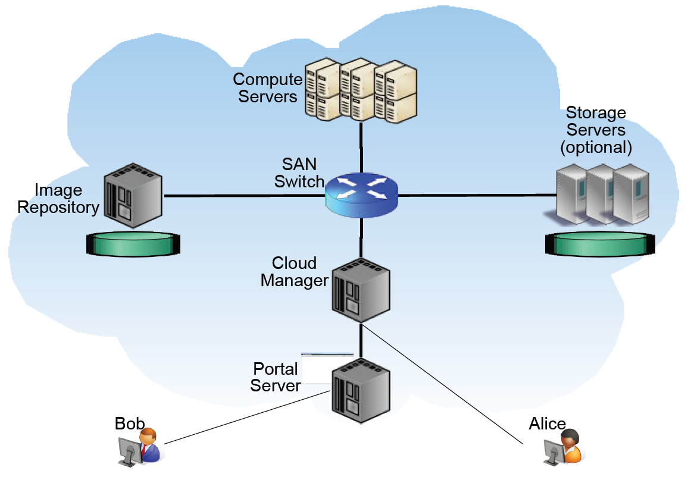

Slide 18
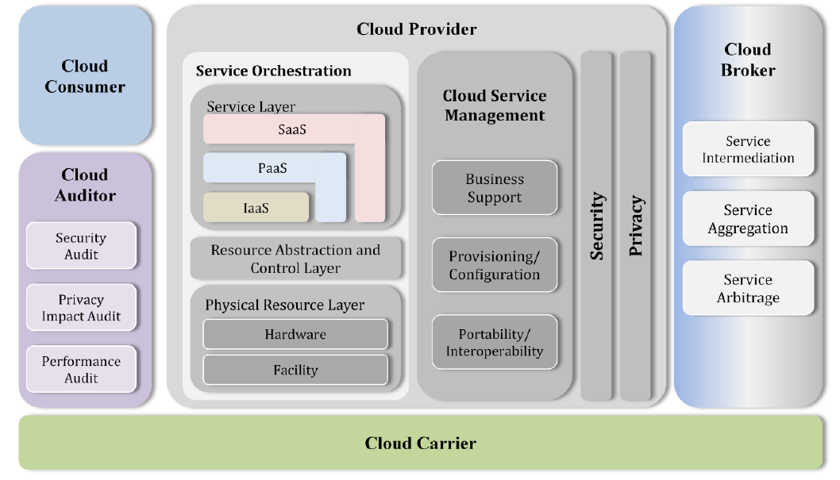
NIST reference architecture

Slide 19
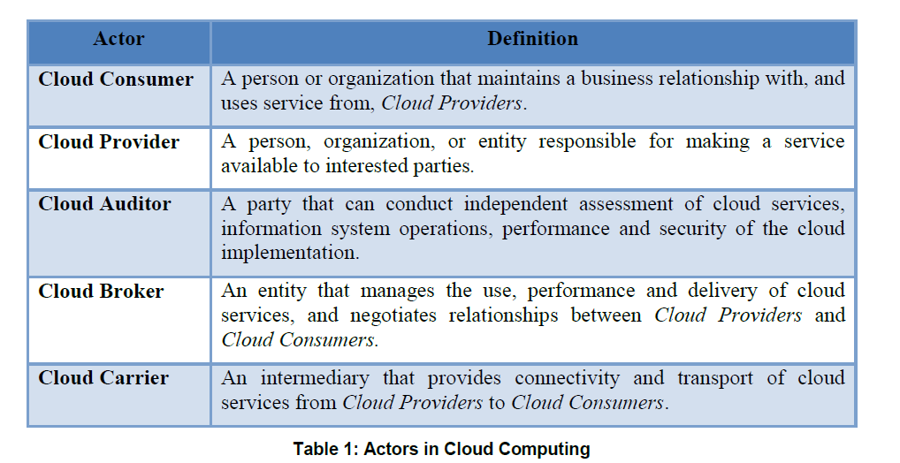

Slide 20
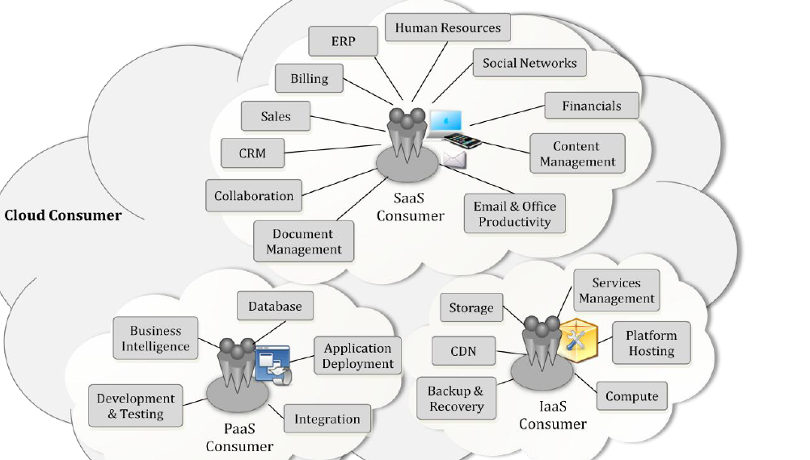
Services available to actors

Slide 21
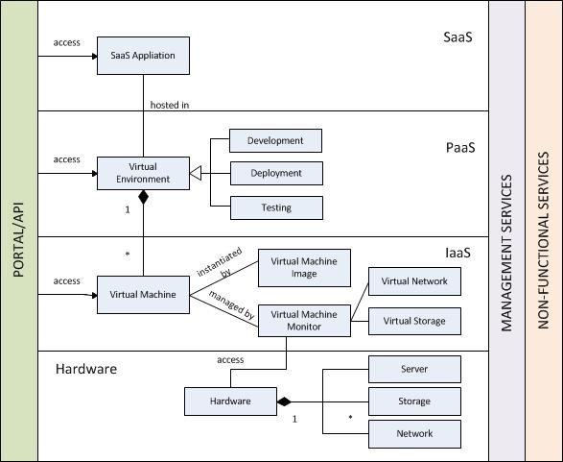
Keiko Hashizume, Eduardo B. Fernandez, and Maria M. Larrondo-Petrie “A Reference Architecture for Cloud Computing

Slide 22
IaaS
The IaaS layer virtualizes computing power, storage and network connectivity, and offers them as services to customers.
Computing power is delivered to users in the form of virtual machines.
A virtual machine looks to its user as a hardware processor where she can install any of the software packages provided by the Cloud Provider or her own software.

Slide 23
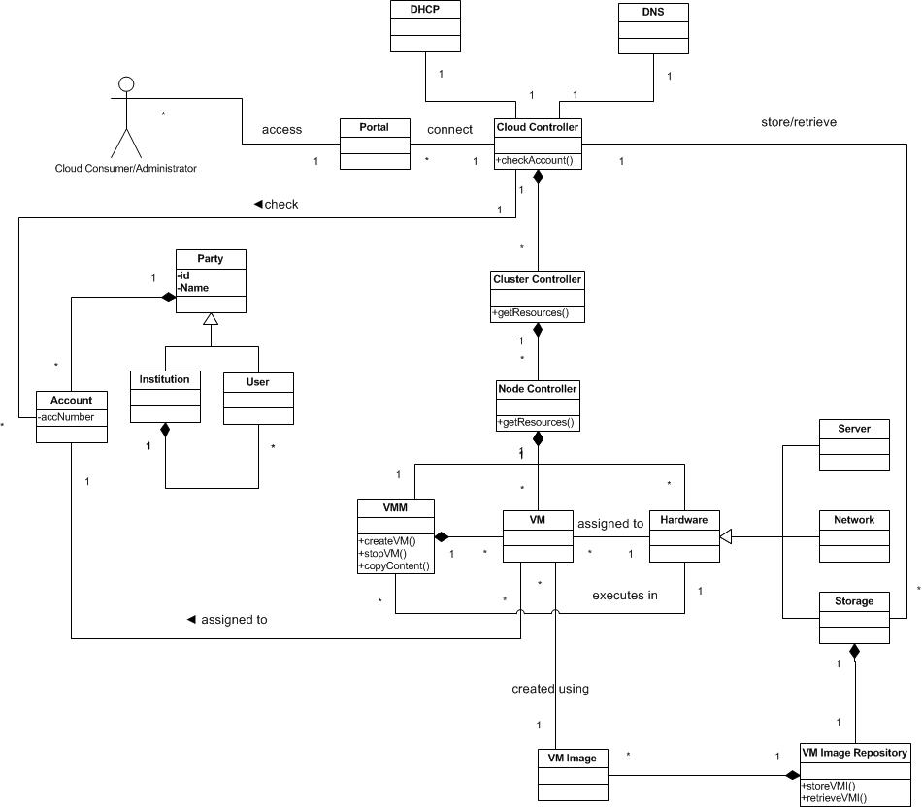
IaaS

Slide 24
System architecture for IaaS
A User creates one or more Accounts in order to use the Provider’s infrastructure.
Accounts can be individual or institutional (Party pattern)
The Provider is composed of a Hypervisor, Hardware (server, storage and network), a DNS (Domain Name System) and a DHCP (Dynamic Host Configuration Protocol).
The Virtual Machine Monitor (VMM) creates Virtual Machines (VM) and assigns their instances to the users who requested them.
VMs are created using Images (VMIs)
When the instance is launched, it is assigned to a physical server and given other hardware resources.
The Virtual Machine passes system calls to the Virtual Machine Monitor which executes those calls in the Hardware.

Slide 25
Use Case Create a VM for a user
Summary: The Provider creates a Virtual Machine for a user.
Actor: User
Precondition: The user must have an account with the Provider
Description:
The User requests the Provider to create a virtual machine. He specifies the physical location and the type of the instance.
The Provider checks if the user has an account and redirects the request to the Hypervisor.
The Virtual Machine Monitor creates an instance of the Virtual Machine and assigns it to a server and to the user.
Postcondition: A Virtual Machine is created in the specified location and assigned to a server and to the user.

Slide 26
UC Create a VM

Slide 27
Application execution
Initially only virtual machines (VMs)were used.
A VM can run any operating system
Lately, containers have become more popular
Applications in containers share a common operating system
Containers trade off flexibility for speed and simplicity

Slide 28
VM stack (system view)

Slide 29
A virtual machine as seen by a user

Slide 30
Containers
A Software Container provides an execution environment for applications sharing a host operating system, binaries, and libraries with other containers.
Containers can be lightweight, portable, extensible, reliable, and secure.
A Container controls a set of Applications sharing a Host OS that provides a set of Resources. An Interceptor mediates the services provided to the application by the container. Applications hosted in containers can be accessed remotely through Proxies, where the Container acts as a broker. The Container provides a set of Services to the applications.

Slide 31
Container stack

Slide 32
OpenStack
OpenStack is a free and open-source software platform for cloud computing, mostly deployed as IaaS. It consists of interrelated components that control hardware pools of processing, storage, and networking resources throughout a data center.
Users either manage it through a web-based dashboard, through command-line tools, or through a RESTful API.
OpenStack.org released it under the terms of the Apache License.
As of 2016, it is managed by the OpenStack Foundation, a non-profit corporate entity established in September 2012 to promote OpenStack software and its community. More than 500 companies have joined the project
The technology consists of a series of interrelated projects that control pools of processing, storage, and networking resources throughout a data center—which users manage through a web-based dashboard, command-line tools, or a RESTful API.
It has become a standard for IaaS

Slide 33
OpenStack components
Compute (Nova)—provides virtual machine management. It is designed to manage and automate pools of computer resources and can work with widely available virtualization technologies
Networking (Neutron)--a system for managing networks and IP addresses
Identity (Keystone)--provides a central directory of users mapped to the OpenStack services they can access
Object storage (Swift)—supports data management using a scalable redundant storage system.
Block storage (Cinder)—provides persistent block-level storage
Image (Glance)—provides discovery, registration, and delivery services for disk and server images
Dashboard (Horizon)—provides administrators and users with a graphical interface (dashboard) to access, provision, and automate cloud-based resources

Slide 34
OpenStack components II
Orchestration (Heat)-- is a service to orchestrate multiple composite cloud applications using templates
Workflow (Mistral)-- is a service that manages workflows using YAML.
Telemetry (Ceilometer)-- provides a Single Point Of Contact for billing systems
Database (Trove)-- is a database-as-a-service provisioning relational and non-relational database engine.
Elastic Map Reduce (Sahara)—manages Hadoop clusters
Bare metal (Ironic)--provisions bare metal machines instead of virtual machines.
Key Manager (Barbican)-- is a REST API designed for the secure storage, provisioning and management of secrets

Slide 35
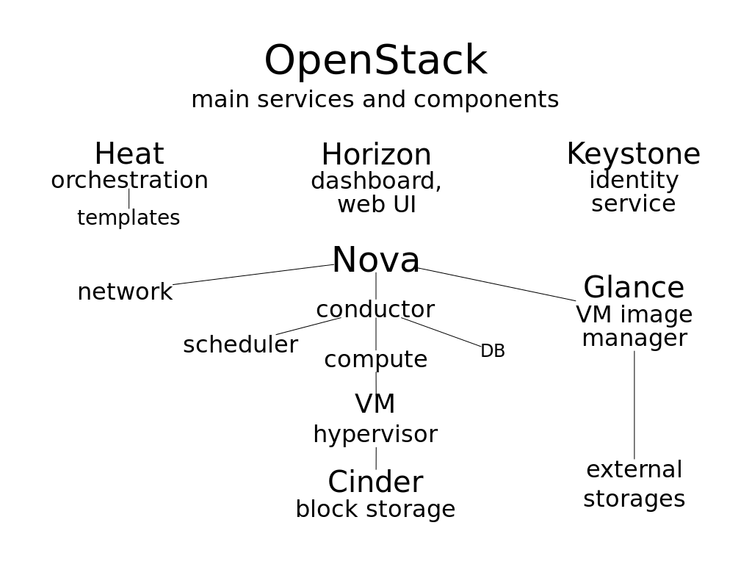
https://en.wikipedia.org/wiki/OpenStack

Slide 36
Service Level Agreement (SLA)
Use of services in Service-oriented architectures (SOAs) require the use of of Service-Level Agreements (SLAs)
A SLA is a contract that specifies clearly the rights and obligations of providers and customers and determines the benefits and responsibilities of each party
The only means the provider can gain trust of clients is through the SLA
Due to the dynamic nature of the cloud, continuous monitoring on Quality of Service (QoS) attributes is necessary to enforce SLAs

Slide 37
SLA elements
Parties: It is composed of two parties: supporting parties and signatory parties. Signatory parties are the service provider and the consumer. Supporting parties are the third parties that act in behalf of the service provider or the consumer.
Service Definitions: describe the services to be delivered in terms of operations and service’s metrics.
Obligations: define the service level that is guaranteed with respect to the metrics defined in service definitions.

Slide 38
Class diagram of a SLA

Slide 39
Security issues of clouds
Secure outsourcing: Customers must trust their sensitive information to a third (and maybe even a fourth) party
Accountability. It may not be clear who is responsible for compliance
Multiple tenancy. Several customers may run their processes in the same hardware, which brings a new set of security threats
Proper sharing of security concerns between customers and cloud providers
The administration of cloud resources and its implication on security and reliability is an aspect about which there is scarce experience
Cloud vendors may provide different degrees of independence; for example, a provider may offer a type of hardware without showing its details or offer specific hardware services
Customers may be unwilling to reveal sensitive data to a third party, as the task specification and problem parameters alone may leak sensitive information.

Slide 40
Study of security issues in clouds
We did first a categorization of security issues for Cloud Computing considering its service models SaaS, PaaS, and IaaS.
We identified the main vulnerabilities and the most important threats.
We also showed some countermeasures related to these threats.
We related compliance to security
We then developed a Security Reference Architecture

Slide 41
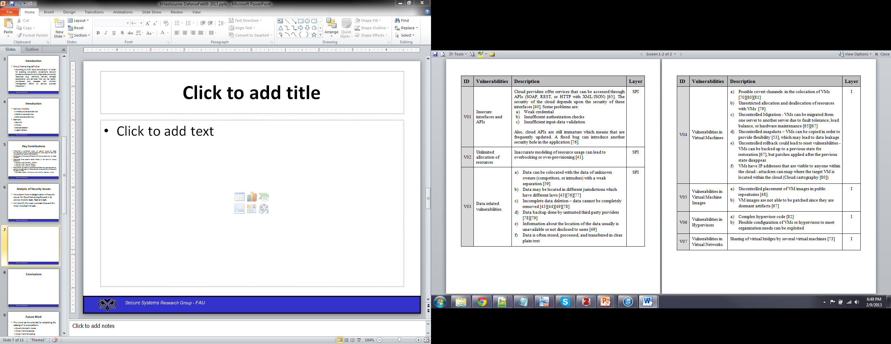
Vulnerabilities in Cloud Computing

Slide 42
Vulnerabilities in Cloud Computing II

Slide 43
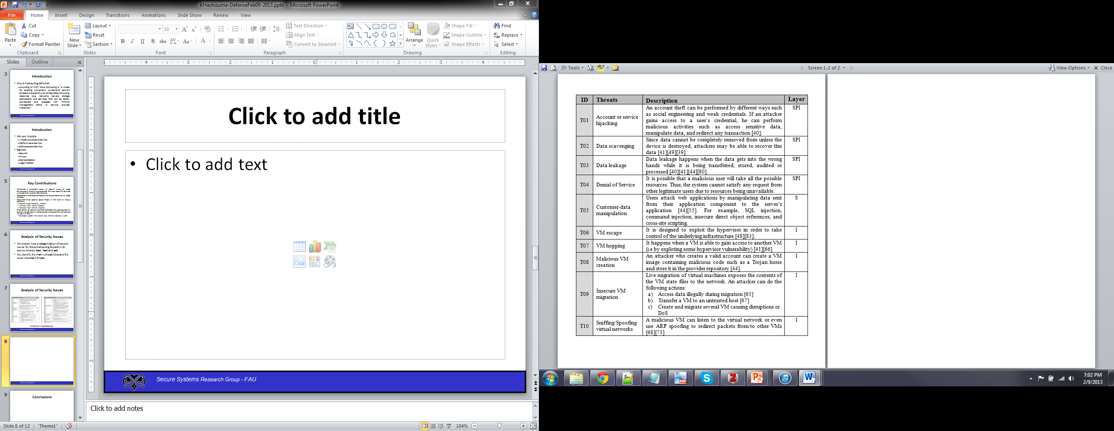
Threats in Cloud Computing

Slide 44
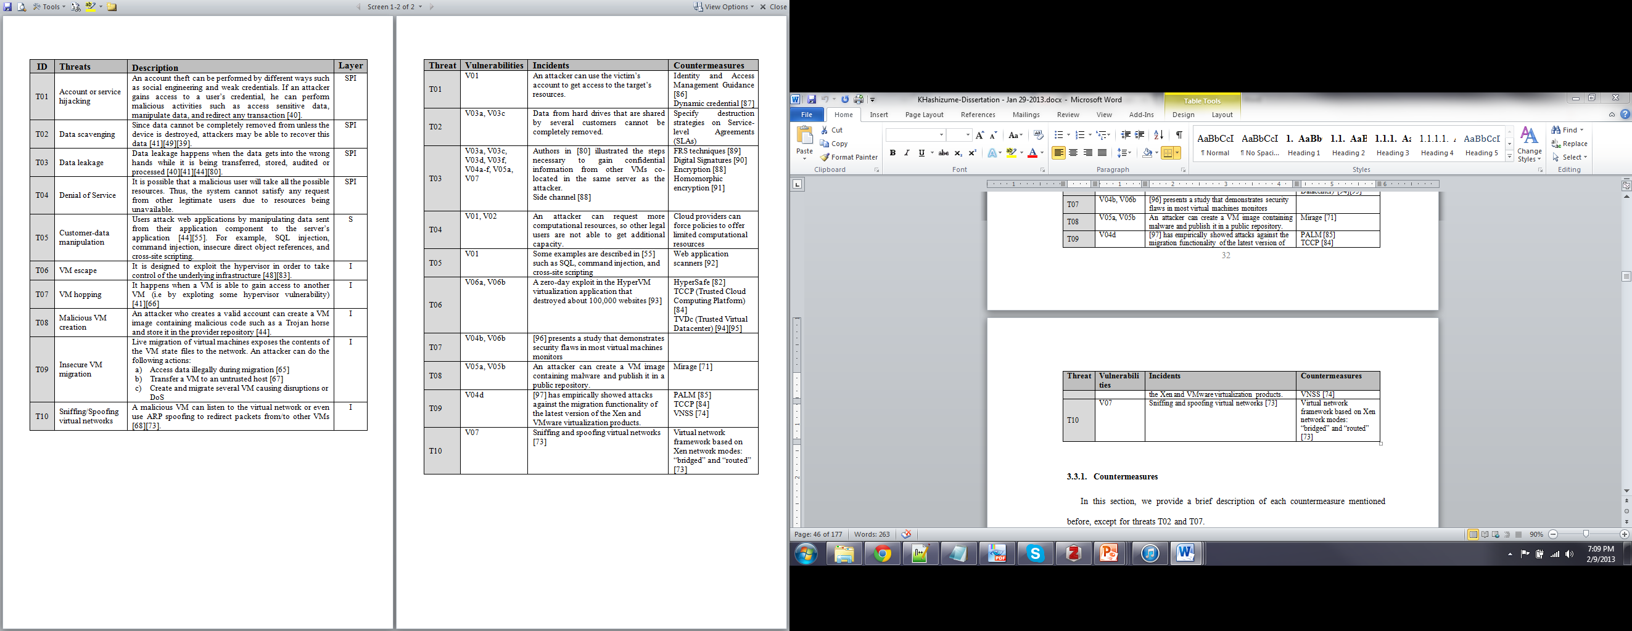
Relationships between Threats, Vulnerabilities, and Countermeasures

Slide 45
Analysis of Security Issues
Attacks to storage, virtualization, and networks are the biggest security concerns in Cloud Computing.
The relationships and dependencies between cloud components may also be a source of security risks.
We need a way to describe in detail how these threats happen so we can avoid them (misuse patterns).
We first built patterns for each layer and then some cloud misuse patterns

Slide 46
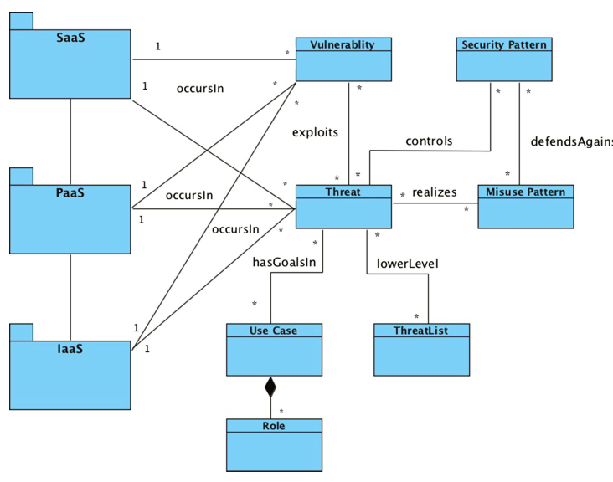
Metamodel for security concepts

Slide 47
Securing a cloud
Vulnerabilities
Security
Analysis
Threats
Cloud
Countermeasures
stopped by
Misuse patterns
Security patterns
Reference Architecture
threats
IaaS
defenses
PaaS
SaaS
defenses
Security best practices

Slide 48
Securing an RA
We start from a list of use cases which describe the typical cloud uses and their associated roles. Lists of cloud use cases are shown in [Bad12], [nis11], and [Has13c].
We analyze each use case looking for vulnerabilities and threats as in [Bra08]. This implies checking each activity in the activity diagram of the use cases to see how it can be attacked. This approach results in a systematic enumeration of threats.
We use the list of threats from [Has13a] to confirm these threats and to find possible further vulnerabilities and threats.
These threats are expressed in the form of misuse patterns. We developed some misuse patterns for Cloud Computing in [Has13b], we show more later.
We apply policies to handle the threats and we identify security patterns to realize the policies. There are also regulatory policies which are realized as security patterns.

Slide 49
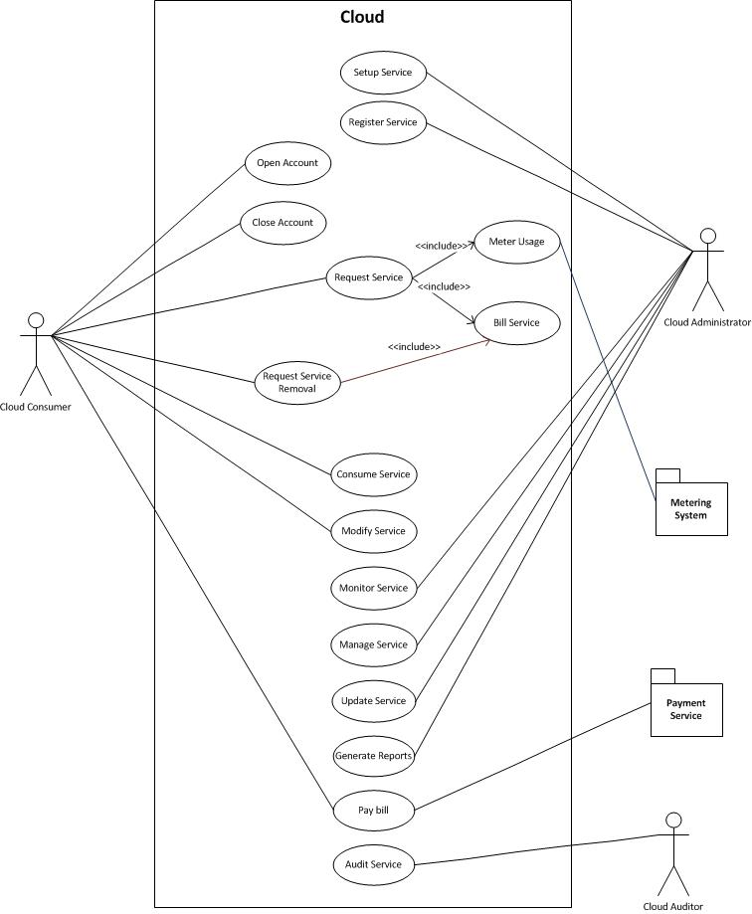

Slide 50
Enumerating threats
We can enumerate threats systematically by considering each activity in each use case and analyzing its possible threats
For illustration we use a running example of a Virtual Machine Image (VMI) Repository, which stores VM images for use by service consumers and which is part of the administrative functions of the cloud
We apply to each action in this repository the STRIDE attacks , e.g. Read a VMI (confidentiality attack), Tamper with a VMI (integrity attack).

Slide 51
Enumerating threats

Slide 52
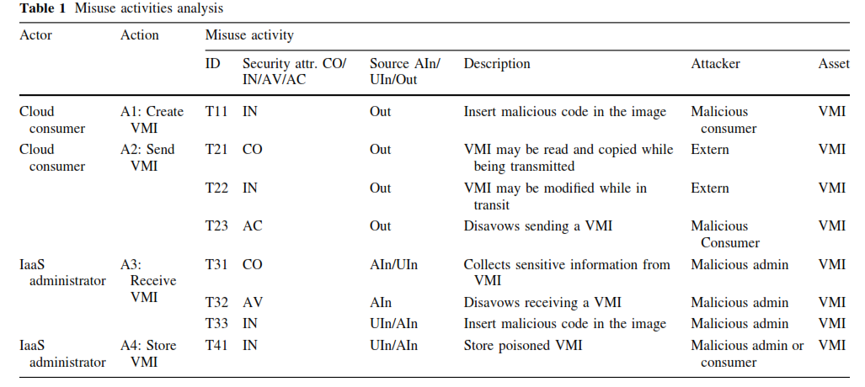

Slide 53
Threats vs. Defenses
ID | Threats | Defense
T11 | The cloud consumer is malicious and inserts malicious code into the VMI | Authenticator - Authorizer
T21 | An external attacker listens to the network to obtain information about the VMI | Secure Channel
T22 | VMI may be modified while in transit | Secure Channel
T23 | Disavows sending a VMI | Security Logger/Auditor
T31 | The IaaS administrator is malicious and collects information within the VMI | Authenticator - Authorizer
T32 | The IaaS disavows receiving a VMI | Security Logger/Auditor
T33 | Insert malicious code in the image | Authenticator - Authorizer
T41 | The IaaS administrator stores a malicious VMI | Authorizer – Authorizer Filter

Slide 54
Applying misuse patterns
Misuse patterns can be used to evaluate the security of a reference architecture.
Normally, misuse patterns can only be used after the requirements stage but here we have already an architecture
We need to build a catalog for cloud misuse patterns.
The catalog is based on the threat analysis of clouds
We started with three misuse patterns for clouds, more are needed

Slide 55
Misuse patterns for clouds
Covert channels in clouds – covert channels allow inter-VM communication bypassing the security rules of the hypervisor.
Virtual machine escape – describes how to exploit the hypervisor in order to take control of the underlying platform.
Virtual machine hopping – describes how a virtual machine can access other virtual machines, for example by exploiting the hypervisor.
Sniffing virtual networks – describes how a virtual machine can listen to the virtual network traffic in order to get confidential information.
Spoofing virtual networks – describes how a malicious virtual machine can intercept information in the virtual network with the purpose of altering its routing function.

Slide 56
Publish a Malicious VM Image [Has11]
Intent
An attacker may create a VM image that contains malicious code.
The attacker may read also confidential data from images.
Context
Some IaaS providers offer a VM image repository where users can retrieve images in order to initialize their VM.

Slide 57
Publish a Malicious VM Image II
Problem
To perform some types of misuse it is necessary to be able to create and publish VM images.
The attack can be performed by taking advantage of the following vulnerabilities:
Any valid user can create and register a VM image.
Common place to share VM images.
VM images contain prepackaged software components for an application.
VM images contain installed and fully configured applications.

Slide 58
Publish a Malicious VM Image III
Solution
Any valid user of the cloud is able to use an image to instantiate his VM.
This VM image can contain malicious code.
The attacker can have control of the VM and perform malicious activities.
Infected VM may appear briefly, infect other virtual machines, and disappear before they can be detected

Slide 59
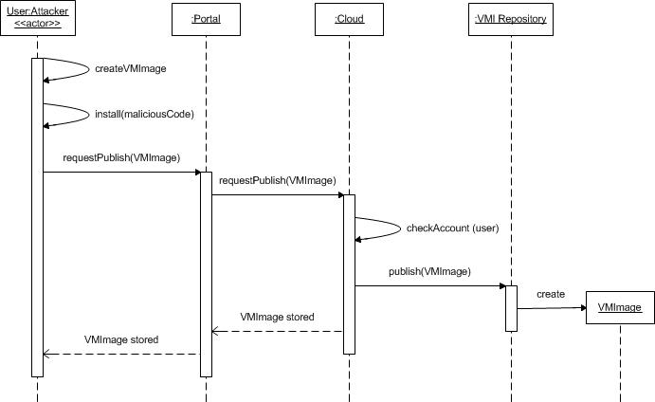
Sequence diagram for Publishing a Malicious VM Image
Sequence Diagram for the Use Case Publish a Malicious VM Image

Slide 60
Cloud security patterns
Secure migration process – provides protection for live and offline migration.
Secure hypervisor – reinforces the security of the hypervisor to avoid some attacks.
Secure virtual network – secures the communication among virtual machines.
Secure DNS, where Access Control Lists (ACLs) are used to protect the DNS (PLoP2014)
Security Group Firewall. Divides the firewall into customer groups that have similar filtering requirements [Fer14b]
Cloud-based Web Application Firewall (CWAF). Controls access to web applications communicating through HTTP according to authorization rules with the objective of stopping XSS, SQL injection, and similar attacks.
Secure DHCP

Slide 61
New Pentagon Weapons Systems Easily Hacked: Report https://www.securityweek.com/new-pentagon-weapons-systems-easily-hacked-report
The Government Accountability Office said the Pentagon was unaware of how easy it could be for an adversary to gain access to the computer software of the weapons systems and operate inside them undetected.
The weak points began with poor password management and unencrypted communications.
But it said access points for the systems continued to grow in number and are not always well-understood by the operators themselves, leaving even non-networked systems deeply vulnerable.
More critically, the report faulted the US military for not incorporating cybersecurity into the design and acquisition process for the computer-dependent weapons, and said weapons developers often did not themselves adequately understand cybersecurity issues.
"Due to this lack of focus on weapon systems cybersecurity, DOD likely has an entire generation of systems that were designed and built without adequately considering cybersecurity," the GAO said.
"In one case, it took a two-person test team just one hour to gain initial access to a weapon system and one day to gain full control of the system they were testing," it said.

Slide 62
Some definitions
A Reference Architecture (RA) is an abstract software architecture, based on one or more domains, with no implementation aspects
An RA should define the fundamental concepts of a system expressed as ASPs and the interactions among these units. An RA should be reusable, extendable, and configurable; that is, it is a kind of composite pattern for whole architectures and it can be instantiated into a concrete software architecture by adding platform aspects
After adding security patterns to neutralize identified threats in an RA we have a Security Reference Architecture (SRA)
We can also add compliance patterns to produce a Compliance Reference Architecture.

Slide 63
SRA
The threat analysis shows how each threat can be controlled by a corresponding security pattern. Once security patterns are selected, we apply them into the RA in order to stop or mitigate threats
Security mechanisms are added to the basic RA, including Authenticator, Authorizer, Security Logger/Auditor and others that mitigate specific threats.
To avoid impostors we can use the Authenticator so that every action with the cloud is authenticated
The Security Logger/Auditor is used to log all activities that can be used for auditing at a later time
For authorization we use Role-Based Access Control (RBAC), or a similar model, so only authorized users can perform some actions to assets.
To avoid storing infected VMI, they are scanned and filtered before storing them in the VMI Repository.
VM=Virtual machine, VMM=virtual machine monitor, VMI= virtual machine image

Slide 66
Secure IaaS

Slide 67
Validation of the SRA
RAs are abstract models and cannot be evaluated with respect to security or performance through experimentation or testing.
An RA is similar to a pattern and it has similar value, it is a paradigm to guide implementation of new systems or evaluation of existing systems.
Their evaluation must be based on how well they represent the relevant concepts of the systems they describe, how well they handle abstract threats, how complete they are, how precise they are, how they can be applied to the design or evaluation of systems, and how useful they are for other relevant functions.
Their final validation comes from practitioners using them to build concrete architectures.
We identified a variety of uses for a cloud SRA

Slide 68
Uses of a SRA
Security Service Level Agreement (SSLA). An RA can provide a framework for defining the requirement of the provider with respect to the requirements of the consumer; the SRA can define the security mechanisms that the SP has or could have and the customer can then select them for the corresponding SSLA. In particular, a SSLA can include several levels and the SRA makes clear where the services belong. SSLAs require monitoring to assure that the SP fulfilled its contact.
Reference for monitoring functions. Monitoring requires mechanisms to obtain information about the system status. A SRA provides guidelines about the places where security events should be collected in order to fulfill SLAs requirements and for system administration.
A way to understand vendor SRAs (can serve as validation also)

Slide 69
More uses of SRAs
A holistic security view. Several authors emphasize the need to develop secure systems in a holistic way. Systems built piecemeal omit important interactions that may result in vulnerabilities. A SRA provides such a holistic view by indicating the places where security mechanisms can be attached and their effect in the functional parts of the architecture. As such a SRA can be useful for developing secure cloud development methodologies. We can expand the SRA by indicating all the points where threats are neutralized with corresponding security patterns. Holistic views are very important to combine quality factors such as safety or reliability with security.
A way to unify cloud terminology. Different vendors have different ways to describe their security services and products. A SRA can be used as a framework to unify terms and descriptions. This is useful for selecting cloud providers. Some ontologies for this purpose exist, but they don’t relate the terms to a RA, much less to a SRA.

Slide 70
SRAs in practice—used to validate our SRA we showed that our model subsumes these models
NIST
IBM
Oracle
Fujitsu
Amazon
VmWare
Cisco
Trend Micro
Intel

Slide 71
Are clouds secure?
Consider a typical business application, e.g. a financial application: high security requirements, remote access, highly available
If it is in our control, we can put authentication, authorization, logging, firewalls, IDS, cryptography, where needed
If in a cloud from some provider, we need to specify the same defenses through the SLA
If provider satisfies these requirements, we need to consider extra threats: Internet access to the cloud itself, multitenancy, insecure images, migration attacks, insider attacks from provider employees,…
Best security in the cloud will always be less than best security under our control
In practice, it is harder to tell because we might not have enough expertise, not enough money for security, …

Slide 72
Assets that must be protected (op=operation, p=process)

Slide 73
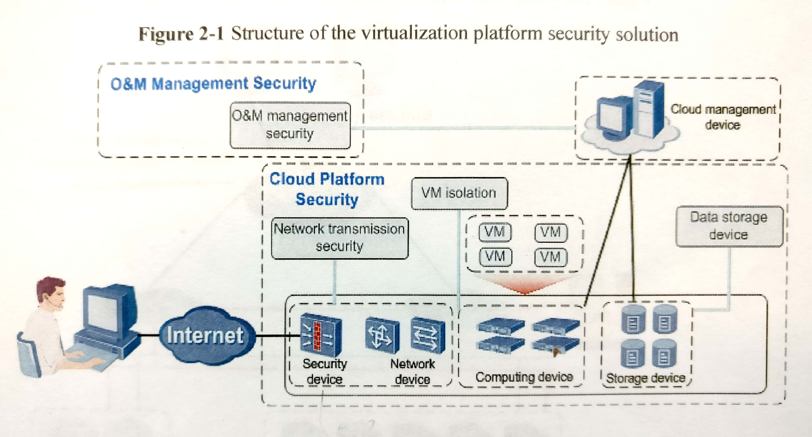

Slide 74
Cloud security defenses
Identification and Authentication (I&A)—Passwords, biometrics, cryptography
Authorization and Access control (A & A)—Authorization systems in application, databases, operating systems
Logging and Auditing (L&A)—In database system and/or operating system
Hiding of information—It is usually performed by the use of cryptography but steganography is another option. Protects messages in transit and databases
Filtering—done using firewalls
Intrusion detection—Intrusion Detection Systems (IDS) combined with Firewalls
(using virtual devices or NFV)
Antimalware: virus detectors
DDoS: partially controlled by replication, IDS, and firewalls
Protection of security information

Slide 75
In summary
For a company that manages well its security, has appropriate expertise, and has installed enough security mechanisms, the cloud may be a decrease in security due to the extra threats, lack of control, and dependency on a provider that may not be as careful.
For a company that does not have enough expertise and not enough money to buy security products, training, etc. , the cloud may be a clear improvement.
The choice is affected by the application requirements, the value of the assets to be put in the cloud, compliance, and quality factors.

Slide 76
Security SLA
Specifies the security obligations of the SP associated with a service
No SP offers them now
SRA can be used as a guideline to specify what the customer wants and to indicate where the contract values can be monitored

Slide 77
Cloud security products
Intel ECA 360
WAF
Lenovo
vmWare
IBM
CASB (Cloud Access Security Broker): several vendors

Slide 78
Cloud-based Web Application Firewall
This technology is unique due to the fact that it is platform agnostic and does not require any hardware or software changes on the host. All providers but one require a DNS change, wherein all web traffic is routed through the WAF where it is inspected and threats are thwarted. Cloud-based WAFs are typically centrally orchestrated, which means that threat detection information is shared among all the tenants of the service. This collaboration results in improved detection rates and lower false positives. Like other cloud-based solutions, this technology is elastic, scalable and is typically offered as a pay-as-you grow service.
XyberShield is the only cloud-based WAF which does not require a DNS change^{[13]}, instead relying upon a local 4k script and constant communication to its global service platform of 55 points of presence.
In 2010, Imperva spun out Incapsula to provide a cloud-based WAF to small to medium sized businesses.
Since 2011, United Security Providers provides the Secure Entry Server as an Amazon EC2 Cloud-based Web Application Firewall
Akamai Technologies offers a cloud-based WAF that incorporates advanced features such as rate control and custom rules enabling it to address both layer 7 and DDoS attacks.
Since 2012, Penta Security Systems, Inc. offers a cloud-based WAF, named WAPPLES V-Series^{[14]}, to the public with the strategic partnership with ISPs including KT, Korea.

Slide 79
Lenovo cloud security
Lenovo has a secure and manageable way of accessing Web applications by adding a cloud-connecting client to its desktop and laptop computers.
Cloud Ready Clients, are ThinkPad laptops and ThinkCentre desktops equipped with client software powered by webNetwork, an application delivery method developed by Lenovo partner Stoneware. The cloud-ready PCs have to be powered by Intel's second-generation Core or Core vPro processors.
Intel is involved because Lenovo uses its application programming interfaces that expose security, management, and power management features in the hardware. These features are used by Lenovo's client software, which it calls Secure Cloud Access.

Slide 80
Lenovo II
For example, customers could tie a fingerprint reader on a PC to a cloud application for authentication. SCA also can be used to automatically detect the hosting device's processor performance, free memory, graphics and available bandwidth, and then fit the application delivery within those parameters.
Available security methods includes SSL or VPN access, integration with Active Directory, eDirectory or LDAP directories, and the ability to incorporate additional layers of authentication when such security measures do not already exist on the device. SCA tries to prevent virus contamination by providing access to corporate applications and print and file resources, while walling off its intranet.
The cloud-ready software allows single sign-on to applications, whether Windows, Web, internal or hosted, and services. This is meant to reduce the number of password resets by IT management. Lenovo also offers a built-in fingerprint reader with its PCs to complement or replace application-unique passwords.
SCA has a starting price of about $80 per user, and is available only in North America.

Slide 81
VmWare security
VMware vCloud Suite is an integrated solution for building and managing a complete cloud infrastructure that meets IT’s most critical needs. vCloud Suite fulfills the promise of the software-defined datacenter by pooling industry-standard hardware and running each layer of the datacenter as software-defined services. It creates pools of servers, storage and networking with dynamically configurable security, availability and management services which can meet the needs of any and all applications. Built-in self-service portal and catalog, policy-based infrastructure and application provisioning and automated operations management help to complete the picture. As delivered by VMware vCloud Suite, the software-defined datacenter provides all the cloud infrastructure characteristics essential for success: Standardized—Homogeneous infrastructure delivered across pools of standard x86 hardware, to eliminate unnecessary complexity. Holistic—A unified platform optimized for the entire datacenter fabric, to support any and all workloads. Adaptive—Self-programmable infrastructure that dynamically configures and reconfigures the environment according to changing application demands. Automated—A management framework with built-in intelligence to eliminate complex and brittle scripting, for cloud-scale operations with less manual effort and significant cost savings. Resilient—A software-based architecture that compensates for failing hardware, delivering unprecedented resiliency at minimum cost. http://www.vmware.com/products/datacenter-virtualization/vcloud-suite/overview.html

Slide 82
Cloud Access Security Broker (CASB) [fer15]
Intent
CASBs are security enforcement points between consumers and service providers that apply security controls to access cloud services, usually SaaS services. They may also control access to internal company resources. Security controls may include authentication (credentials and passwords), authorization policy enforcement, intrusion prevention, antimalware filters, security logging/auditing, and encryption.

Slide 83
Solution idea

Slide 84
Class diagram of CASB

Slide 85
Solution
Consumers (users) request services through the Broker, which in turn gets them from one of the Service Providers
The Broker includes a set of security mechanisms such as a SecurityLogger/Auditor, an Authorizer, an Authenticator, an Encryptor, and maybe others
Consumers and CASBs can be mutually authenticated. The CASB enforces rights for the consumers when they try to access an application. InternalResources (applications) can also be controlled by the CASB. An Identity Federation provides identifiers across consumers and SPs.

Slide 86
Use case “Access an application service”

Slide 87
Known uses
Adallom [Ada15]—integrates with the authentication services in SaaS to let institutions monitor the activities of users in any location and any device. This product includes a behavior analysis component to assess the possible risk of specific transactions.
Bitglass [Bit]—provides RBAC, encryption, session control, identity, and DRM.
Cipher Cloud [Cip]-- protection controls include encryption, tokenization, monitoring, data loss prevention, and malware detection.
Elastica Cloudsoc [Ela15]—Provides authentication, authorization, monitoring, and other services. It can interact with third-party APIs.
Skyhigh Networks [Sky]—includes encryption, logging/auditing, access control, and anomaly detection (IDS). It also provides risk ratings of cloud services. Integrates authentication with standards such as SAML.
IBM (http://www-03.ibm.com/security/cloud/cloud-security-enforcer.html)

Slide 88
Compliance
Compliance is the application of rules designed to enforce standards based on established laws, regulations, specifications, and best practices
The complexity and the number of standards are increasing with the advancement of technologies and consumer needs.
Compliance varies from country to country. In most cases, they share almost identical rules and regulations customized to their local needs.

Slide 89
Compliance II
Compliance may require the use of multiple IT attributes such as confidentiality, integrity, availability, reliability, and accountability
Compliance comes with a high cost of implementation and maintenance.
Failing to comply could result in penalty fees, lawsuits, and bad business reputation
There are a number of standards such as PCI DSS, HIPAA, GLBA, SOX, European Union Data Privacy and many others

Slide 90
Some regulations
Health: HIPAA
Finance: Sarbanes/Oxley (SOX)
Gramm–Leach–Bliley Act (GLB), also known as the Financial Services Modernization Act
Government: FEMA
Privacy: P3P
PCI: credit card
These regulations can be expressed as policies (seen in Chapter 3)

Slide 91
Cloud compliance issues
Every regulation requires organizations to adequately protect their physical and informational assets. To do this, there is an implied or assumed ability to control and prove:
What information is stored on the system?
Where is the information stored?
Who can access the system?
What they can access?
How is the data protected?
What data backup they use?
How you may reserve the right to audit the security and compliance framework that they build around your data.
Do they have an incident response plan which should cover any type of legal requests to get access to data stored on the cloud
All this should be in the SLA

Slide 92
An approach to compliance [Yim16]
Precise understanding of rules using reference architecture, patterns and modeling tools
Use patterns and well known security APIs instead of reinventing the wheel
Take advantage of analogies and overlaps to reuse knowledge
Enforce the standard in all stages of the software development lifecycle

Slide 93
Governance
Governance means establishing and enforcing how a group agrees to work together in co-ordination. Specifically, governance is the establishment of:
Chains of responsibility to assign duties and rights to people
Measurement to gauge effectiveness
Policies to guide the organization to meet its goals
Control mechanisms to ensure compliance
Communication to keep all required parties informed
Governance determines what decisions are to be made, who should be making the decisions and what policies should be considered before making any decisions

Slide 94
In practice
Governance guides the development of reusable services and establishes how the services should be designed and developed and how those services should change over time. It establishes agreements between the providers of services and the consumers of those services, telling the consumers what they can expect and the providers what they're obligated to provide.
Governance is a set of practices that is applicable throughout the various stages of a service-oriented architecture such as service definition, service deployment lifecycle, service versioning, service migration, service registries, service message model, service monitoring, service ownership, service testing and service security.
Governance is typically enacted by a center of excellence (COE) which is a board of knowledgeable practitioners who establish and supervise policies to help ensure an enterprise's success. The COE establishes policies for identification and development of services, establishment of SLAs, management of registries, and other efforts that provide effective governance.
Governance policies can be enforced through a combination of an enterprise service bus (ESB) and a service registry. A service can be exposed so that only certain ESBs can invoke it. Then the ESB/registry combination can control the consumers' access, monitor usage, measure SLA compliance, and so on. This way, the services focus on providing the business functionality and the ESB/registry focuses on aspects of governance.

Slide 95
Secure configuration management
CM planning—roles, configuration database, tools, processes, policies
Configuration identification—item identification and compliance
Configuration control—monitoring, change management
https://www.sans.org/reading_room/analysts_program/Sec_Config_Mgt_Tripwire.pdf

Slide 96
Cloud management patterns [Fer13]

Slide 97
Forces
Expressiveness. We should be able to represent any policies or constraints to decide access.
Security. Access and identity information should only be manipulated by authorized people.
Usability. The information about access should be presented to the security administrator in a clear and systematic way.
Scalability. The number of users and the number of roles should be able to be increased conveniently.
Extensibility. We should be able to add new management functions in a convenient way.
Flexibility. It should be easy to change policies about security.

Slide 98
Use cases for PMP

Slide 99
PMP pattern

Slide 100
Repository pattern http://msdn.microsoft.com/en-us/library/ff649690.aspx
In many applications, the business logic accesses data from data stores such as databases, SharePoint lists, or Web services. Directly accessing the data can result in the following:
Duplicated code
A higher potential for programming errors
Weak typing of the business data
Difficulty in centralizing data-related policies such as caching
An inability to easily test the business logic in isolation from external dependencies

Slide 101
Repository II
Use the Repository pattern to achieve one or more of the following objectives:
You want to maximize the amount of code that can be tested with automation and to isolate the data layer to support unit testing.
You access the data source from many locations and want to apply centrally managed, consistent access rules and logic.
You want to implement and centralize a caching strategy for the data source.
You want to improve the code's maintainability and readability by separating business logic from data or service access logic.
You want to use business entities that are strongly typed so that you can identify problems at compile time instead of at run time.
You want to associate a behavior with the related data. For example, you want to calculate fields or enforce complex relationships or business rules between the data elements within an entity.
You want to apply a domain model to simplify complex business logic.

Slide 102
Repository Solution
Use a repository to separate the logic that retrieves the data and maps it to the entity model from the business logic that acts on the model. The business logic should be agnostic to the type of data that comprises the data source layer. For example, the data source layer can be a database, a SharePoint list, or a Web service.
The repository mediates between the data source layer and the business layers of the application. It queries the data source for the data, maps the data from the data source to a business entity, and persists changes in the business entity to the data source. A repository separates the business logic from the interactions with the underlying data source or Web service. The separation between the data and business tiers has three benefits:
It centralizes the data logic or Web service access logic.
It provides a substitution point for the unit tests.
It provides a flexible architecture that can be adapted as the overall design of the application evolves.

Slide 103
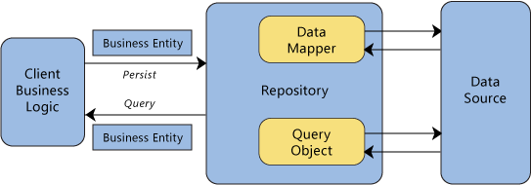
Repository interactions

Slide 104
Interclouds
An Inter-Cloud is a system in which heterogeneous service providers join their services in order to provide an extensive catalog of services to their Consumers and enlarge their resource pool. Inter-Cloud can be classified into two modes, federated and non-federated, the first one is also called federated Inter-Cloud and the second Multi-Cloud. In federated Inter-Cloud, Service Providers (SP) can share their capabilities in order to supply a large amount of services/resources to their clients .
The Cloud Broker’s aim is to decentralize the satisfaction of requests using the Cloud Exchange component; for that reason, their main use cases are related to the forwarding of request across the Service Provider and the Cloud Exchange. It is reasonable also to think in the Cloud Broker as a cache.

Slide 105
Cloud Federation pattern
A Service Provider is part of a Cloud Federation and processes requests from Consumers through a Portal. The Service Provider can be assembled in different ways such as an aggregation of clouds, a set of peers, implied, etc. The Service Provider performs requests to a Cloud Broker. The Cloud Broker redirects the request to the Cloud Exchange component. The Cloud Exchange consults its Catalog (a.k.a. Information Repository) looking for the best match for the request. The Catalog lists several kinds of Services. The Cloud Exchange is aware of the condition of the entire system through status information coming from Cloud Brokers. The Catalog is updated considering the information sent by the Cloud Brokers.

Slide 106
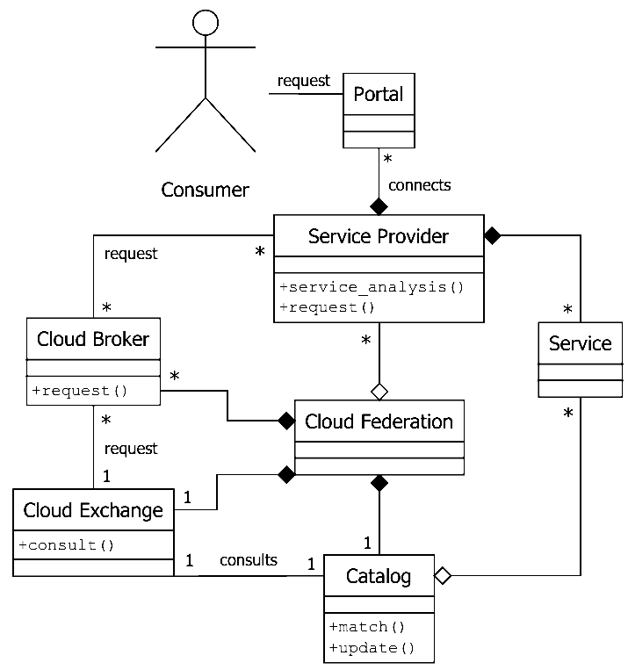
Class diagram of a Cloud Federation

Slide 107
Cloud ecosystems
Ecosystems were initially defined from a biological perspective: systems formed by the interaction of a community of organisms with their physical environment
The term was later applied to software systems: “a collection of software systems, which are developed and co-evolve in the same environment”
Another definition: the expansion of a software product line architecture to include systems outside the product which interact with the product
An ecosystem is advantageous to suppliers who can offer a larger variety of products or services, and to consumers who can find more products to help them reach their business goals
Several companies are developing ecosystems around their products, e.g. Cisco, Apple, and Microsoft.
In cloud ecosystems their complementary systems may not be produced by the same vendor and may use different protocols although able to interact with other products in the ecosystem.

Slide 108
Pattern Diagram of a Cloud Ecosystem

Slide 109
The core pattern of this ecosystem is the Cloud Reference Architecture (Cloud RA) .
Addition of security patterns to a Cloud RA converts it into a Cloud Security RA (Cloud SRA). The Cloud SRA includes security patterns for Authentication, Authorization, and Logging, among others, which can help control known threats to the cloud
Patterns that describe how regulations apply to the Cloud RA are included in the Cloud Compliant RA
Other components of the ecosystem include the service layers of a cloud, IaaS, PaaS and SaaS .
Network Functions Virtualization (NFV) is a network architecture where network functions are provisioned in software using virtualization.
Filtering functions are provided by Cloud Web Application Firewalls (Cloud WAF) and Security Group Firewalls (SecGroup FW).
Cloud Access Security Brokers (CASBs) are security enforcement points between consumers and service providers that apply security controls to access cloud services, usually SaaS services.
Recent entities that have been added to this ecosystem include containers and fog computing.

Slide 110
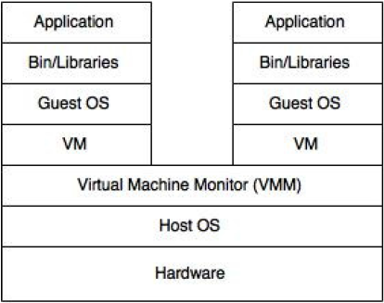
Software Container
Intent: A Software Container provides an execution environment for applications sharing a host OS, binaries, and libraries with other containers with strong isolation between them.
Containers are lightweight, portable, extensible, reliable, and secure.
Docker is a popular example of software containers.
Figure 1. “Two containers sharing one OS” vs “A Virtual machine”

Slide 111
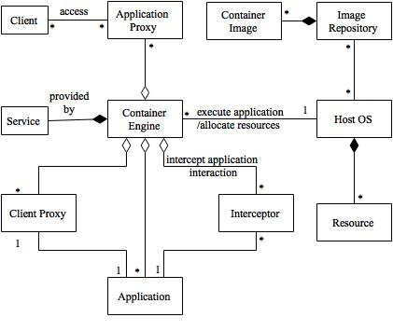

The Software Container Pattern
A Container controls a set of Applications sharing a Host OS that provides a set of Resources.
An Interceptor mediates the services provided to the application by the container.
Applications hosted in containers can be accessed remotely through Proxies, where the Container acts as a broker.
The client interacts with the Application Proxy, which represents the application.
The application interacts with the Client Proxy, which represents the client.
The Container provides a set of Services to the applications.
Figure: Class Diagram for Software Container Pattern

Slide 112
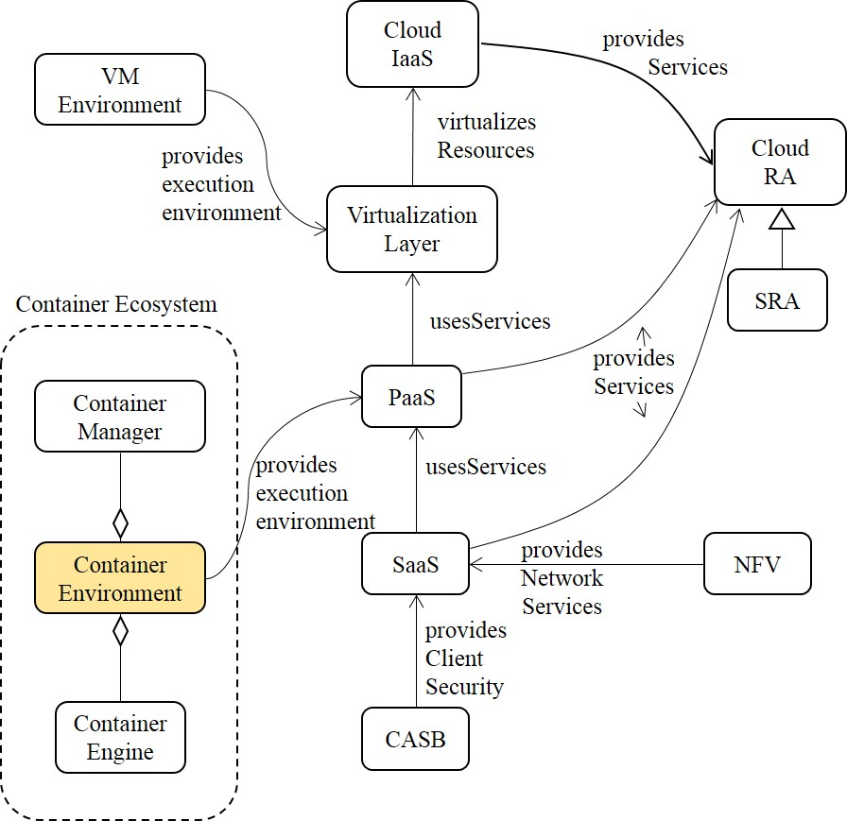
Another view of a cloud Cloud Ecosystem

Slide 113
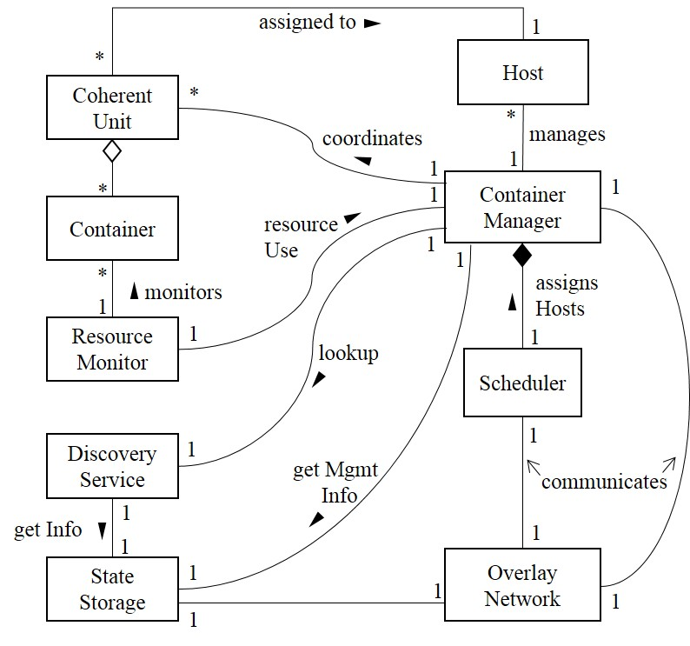
Solution
Provide a high level controller, a Container Manager, which can orchestrate and manage the execution of clusters of Containers across multiple hosts.
A container manager manages a diverse set of containers and their mutual dependencies and interactions by grouping closely related containers into sets, named Coherent Units (CU). Containers in a CU are managed as a single entity. They have the same lifecycle, same environment as they share resources on the same host.
The Scheduler assigns CUs to hosts which meet requirements such as resources.
The Overlay Network allows CUs to communicate with each other within and across hosts by providing a consistent networking interface. Each CU is assigned an IP address (it can change as hosts are changed).
The Discovery Service allows processes and services in a cluster to locate and communicate with each other.
The State Storage stores information about cluster states and provides this data for scheduling and orchestration.
The Resource Monitor collects and provides health and resource allocation/usage data for each host.
Figure. Class diagram of the Container Manager pattern

Slide 114
References
K. Beckers, I. Coté, S. Fassbender, M. Heisel, and S. Hofbauer, “A pattern-based method for establishing a cloud-specific information security management system”, Requirements Eng. vol. 18, 2013, 343-395.
[Fer15] E.B. Fernandez, Nobukazu Yoshioka, Hironori Washizaki, “Cloud Access Security Broker (CASB): A pattern for accessing secure cloud services”, Procs. of 4th AsianPLoP (Pattern Languages of Programs) 2015, Tokyo, Japan, March 2015.
M.R. Head, A. Sailer, H. Shaikh, and M. Viswanathan, IBM http://domino.research.ibm.com/library/cyberdig.nsf/papers/F56608FC1F69819185257669005E6167/$File/rc24883.pdf
Karuna Pande Joshi et al., "Automating Cloud Services Lifecycle through Semantic technologies", IEEE Transactions on Service Computing, January 2014
[Yim16] Dereje Yimam and Eduardo B. Fernandez, A Survey of compliance issues in cloud computing, Journal of Internet Services and Applications, 2016, 7:5 DOI: 10.1186/s13174-016-0046-8, http://www.jisajournal.com/content/7/1/5

Slide 115
References II
E.B.Fernandez, Raul Monge, and Keiko Hashizume, “Building a security reference architecture for cloud systems”, Requirements Engineering. DOI: 10.1007/s00766-014-0218-7 , 2015
Keiko Hashizume, David G. Rosado, Eduardo Fernández-Medina, Eduardo B. Fernandez, “An Analysis of Security issues for Cloud Computing”, Journal of Internet Services and Applications 2013, 4:5 (27 February 2013)
https://cloudsecurityalliance.org/download/cloud-computing-vulnerability-incidents-a-statistical-overview/

Slide 116
Refs. III
K. Hashizume, E. B. Fernandez, and M. M. Larrondo-Petrie, “Cloud Service Model Patterns,” in 19th Conference on Pattern Languages of Programs, 2012.
K. Hashizume, E. B. Fernandez, and M. M. Larrondo-Petrie, “A pattern for Software-as-a-Service in Clouds,” in Workshop on Redefining and Integrating Security Engineering (RISE’12), Washington, DC, USA, 2012.
K. Hashizume, E. B. Fernandez, and M. M. Larrondo-Petrie, “Cloud Infrastructure Pattern,” in First International Symposium on Software Architecture and Patterns, in conjunction with the 10th Latin American and Caribbean Conference for Engineering and Technology, Panama, 2012.
K. Hashizume, N. Yoshioka, and E. B. Fernandez, “Three Misuse Patterns for Cloud Computing,” in Security Engineering for Cloud Computing: Approaches and Tools, D. G. Rosado, D. Mellado, E. Fernandez-Medina, and M. Piattini, Eds. IGI Global, 2013, pp. 36–53.
[Has11] Keiko Hashizume, Eduardo B. Fernandez, and Nobukazu Yoshioka, "Misuse patterns for cloud computing: Malicious virtual machine creation"", Procs. of the Twenty-Third International Conference on Software Engineering and Knowledge Engineering (SEKE 2011), Miami Beach, USA, July 7-9, 2011

Slide 117
References IV
E.B. Fernandez, Raul Monge, and Keiko Hashizume, "Two patterns for cloud computing: Secure Virtual Machine Image Repository and Cloud Policy Management Point"20th Conf. on Pattern Languages of Programs (PLoP 2013)
E. B. Fernandez, Nobukazu Yoshioka, and Hironori Washizaki, “Patterns for cloud firewalls”, Procs. of AsianPLoP (Pattern Languages of Programs) 2014, Tokyo, Japan, March 2014.
Oscar Encina, E.B. Fernandez, and Raúl Monge, “A misuse pattern for Denial-of-Service in federated Inter-Clouds”, Procs. of AsianPLoP (Pattern Languages of Programs) 2014, Tokyo, Japan, March 2014.
D.A,B.Fernandes, et al., “Security issues in cloud environment”, Int. J. of Information Security, 2014.
A. Juels and A. Oprea, "New approaches to security and availability for cloud data", Comm. of the ACM, vol. 56, No 2, February 2013, 64-73.

Slide 118
Refs. V
[Ama] Amazon Web Services LLC, “Amazon Elastic Compute Cloud (Amazon EC2)”, http://aws.amazon.com/ec2
https://aws.amazon.com/security/security-resources/
[Daw] W. Dawoud, I. Takouna, and C. Meinel, “Infrastructure as a Service Security: Challenges and Solutions”, the 7th International Conference on Informatics and Systems, 2010
[Hut10] G. Hutch, “Getting the most out of Virtualization”, The Architecture Journal, http://msdn.microsoft.com/en-us/architecture/ff803574.aspx
[Nur09] D. Nurmi, et al., “The Eucalyptus Open-source Cloud-computing system”, 9th IEEE/ACM Int. Symposium on Cluster Computing and the grid, 2009, 124-131.
[VMw] VMware, http://www.vmware.com

